Slide 1
O
Bimonthly Clinical meeting
Bharatpur Hospital
Bharatpur Chitwan
25-05-2080 / 11th Sept 2023

Slide 4
T
Management of Trauma

Slide 5
Scenario in Nepal

Slide 6
Scenario in Nepal

Slide 7
Principles and Modalities of treatment are changing
Were we doing justice to the patients treated with the outdated Principle or Modality of Treatment ???????

Slide 8
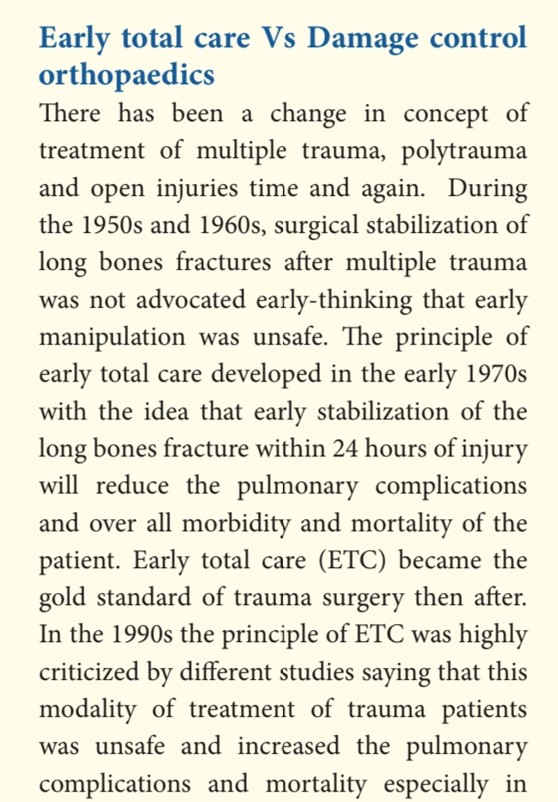
We
Follow

Slide 9
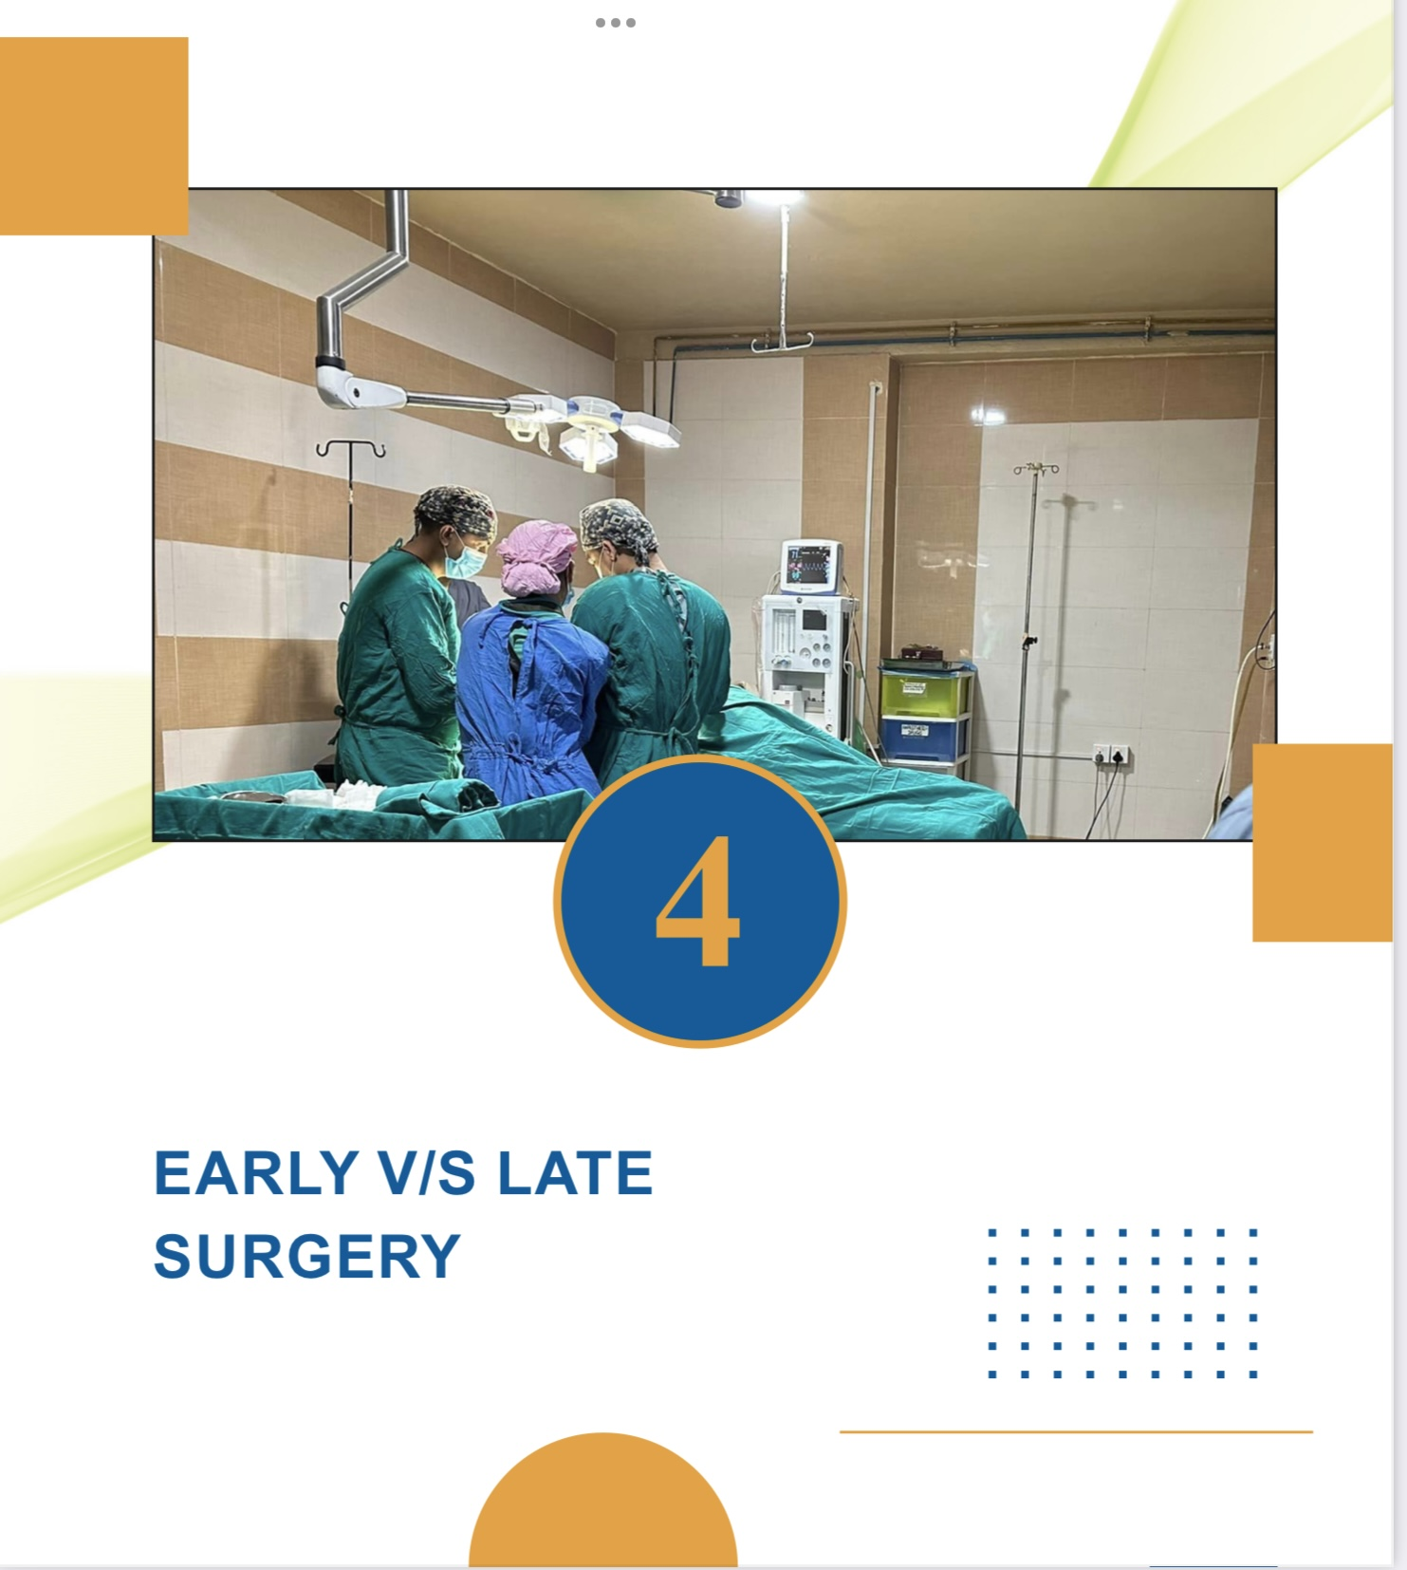

Slide 10
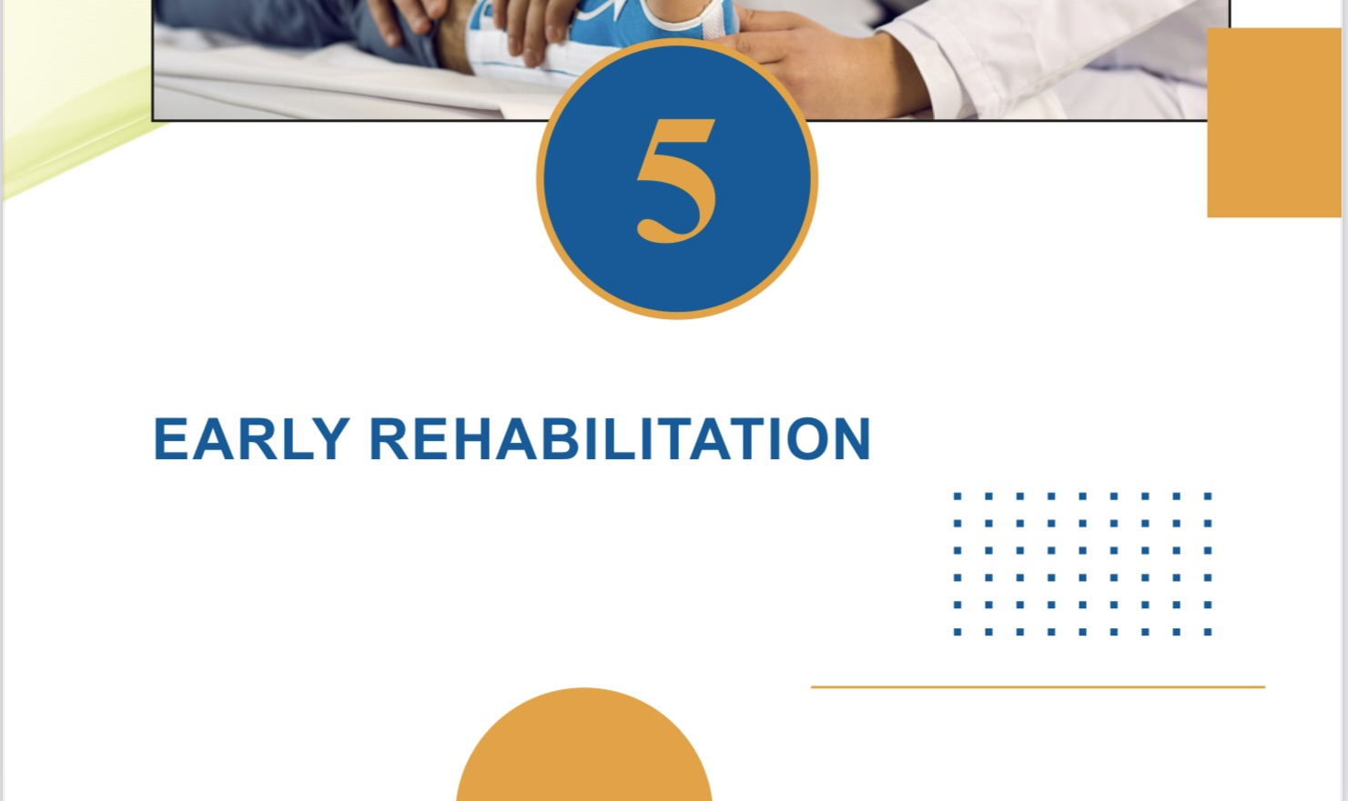
Early Rehabilitation

Slide 12
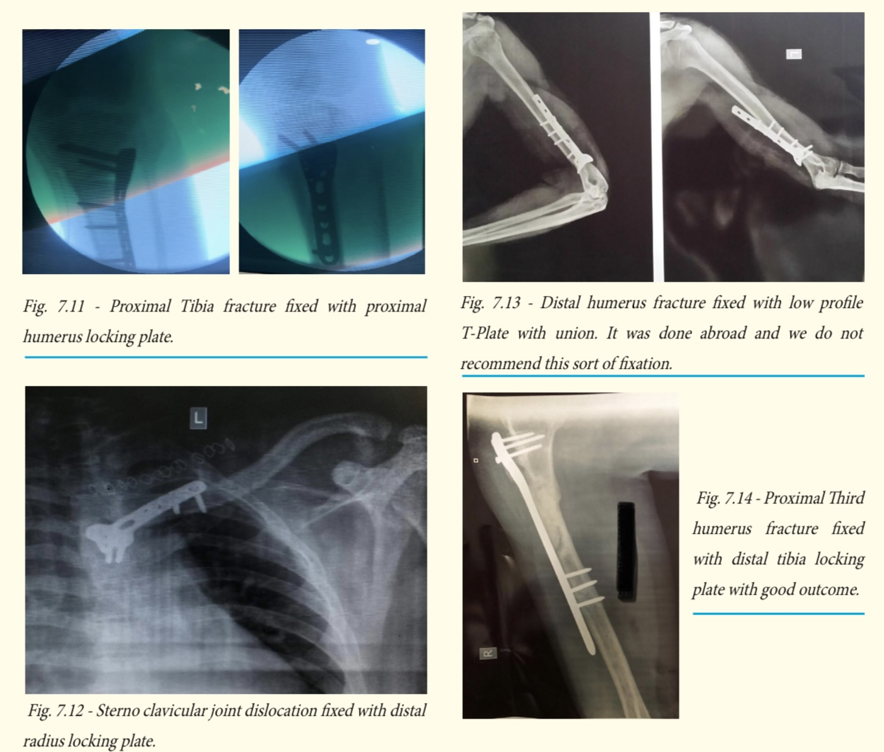

Slide 13
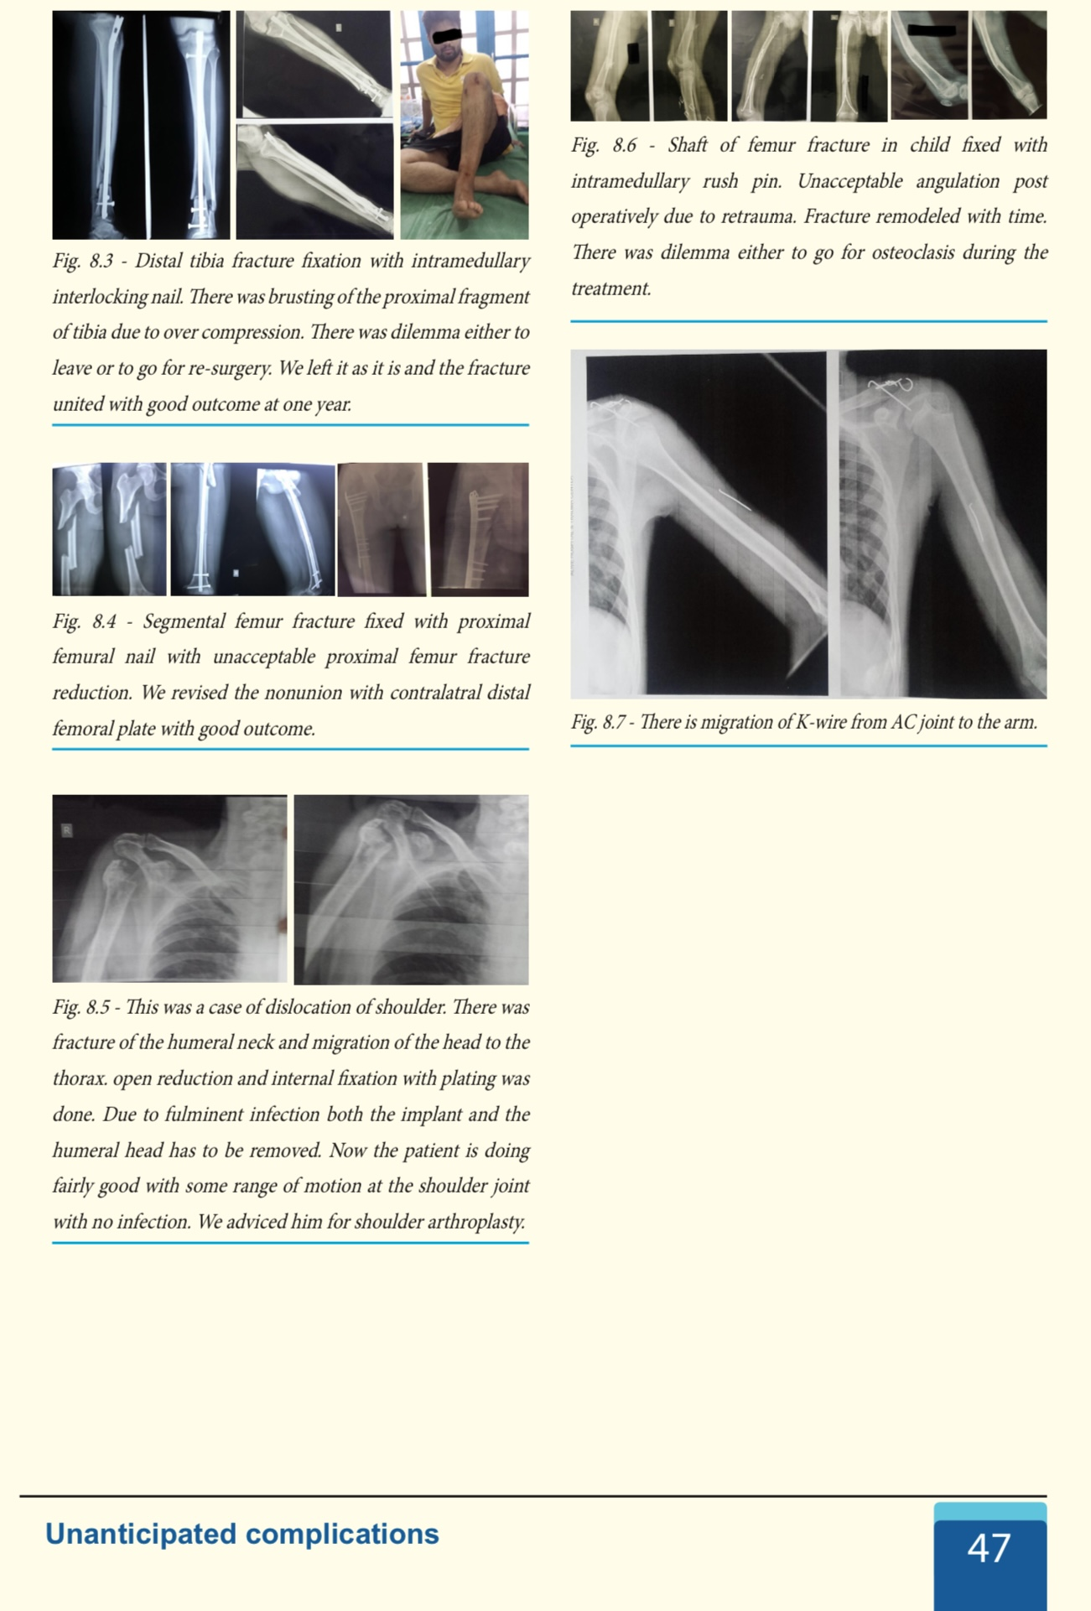

Slide 17
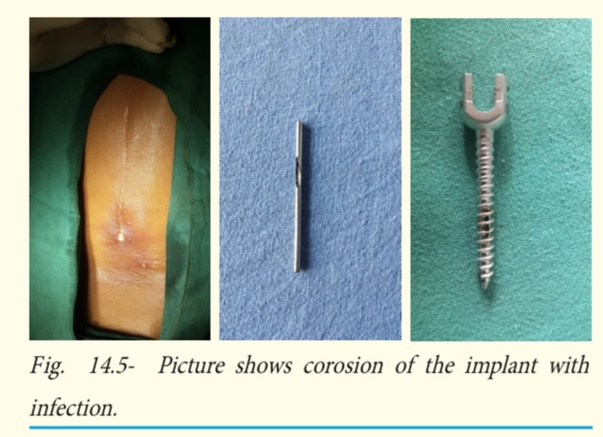
Implant Factor

Slide 18
Stable Fixation
Removal of Soft tissue between the # ends
Atrophic Nonunion- Bone grafting

Slide 20
Shoulder Pericapsulitis

Slide 21
Radial Head #

Slide 23
Thank
You

